Slide 1
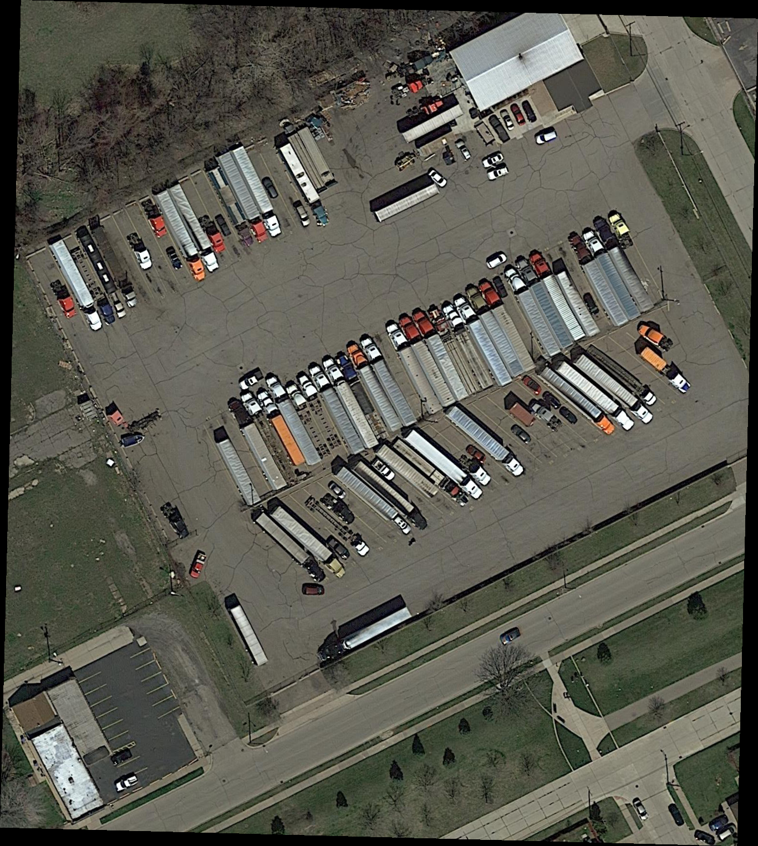
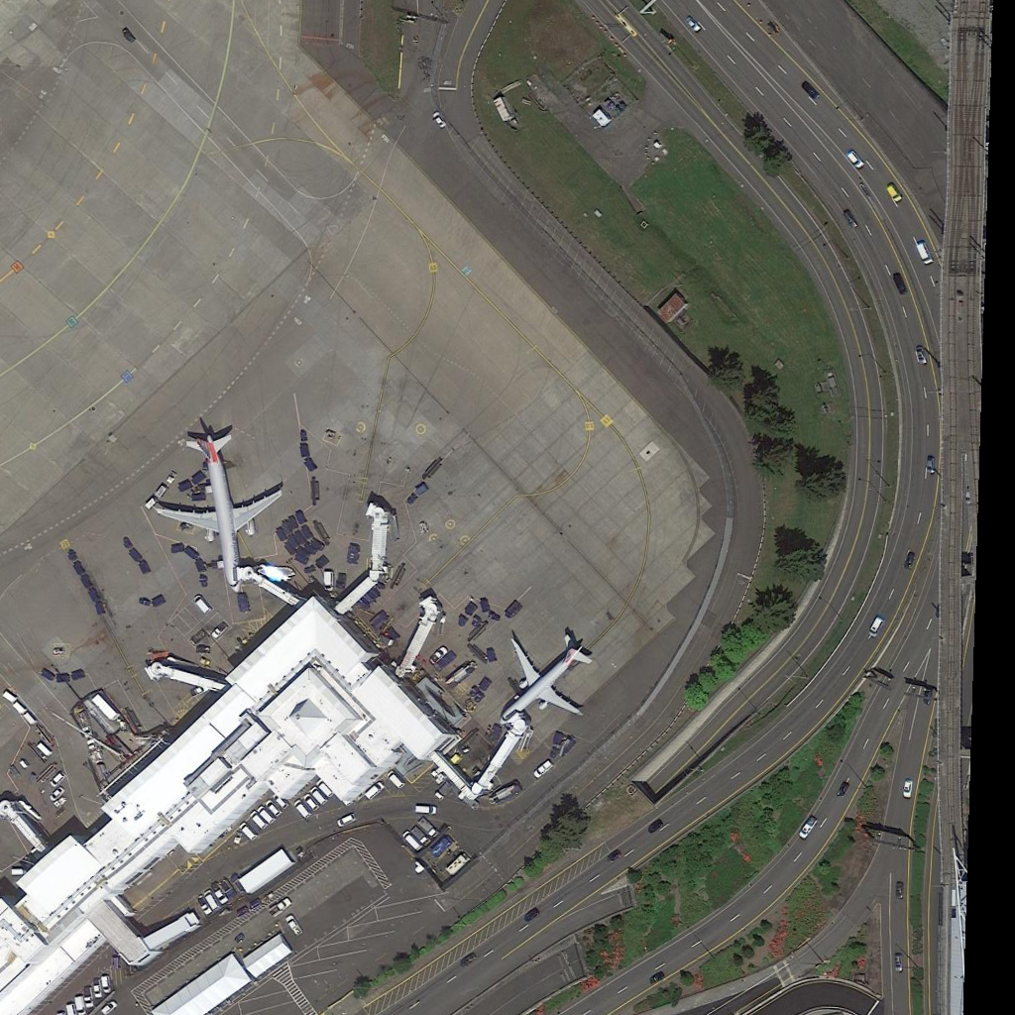
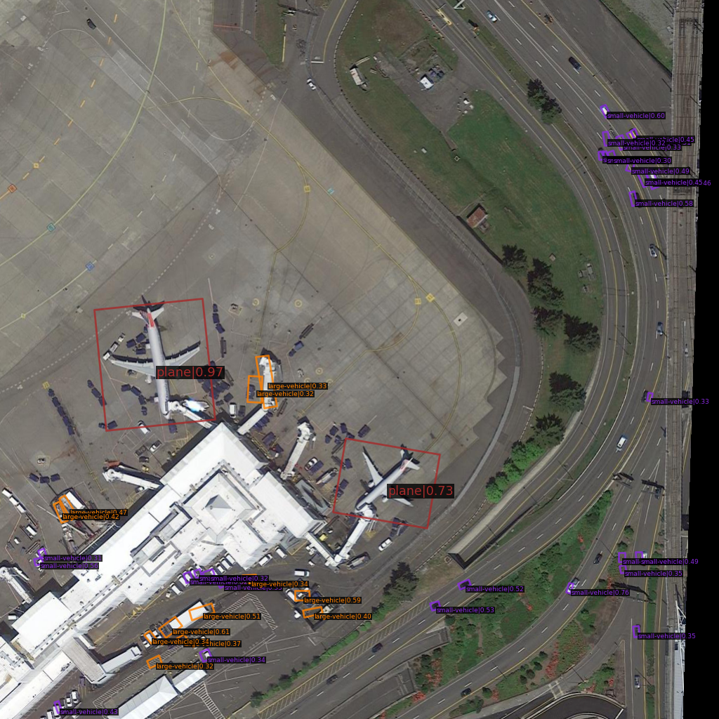
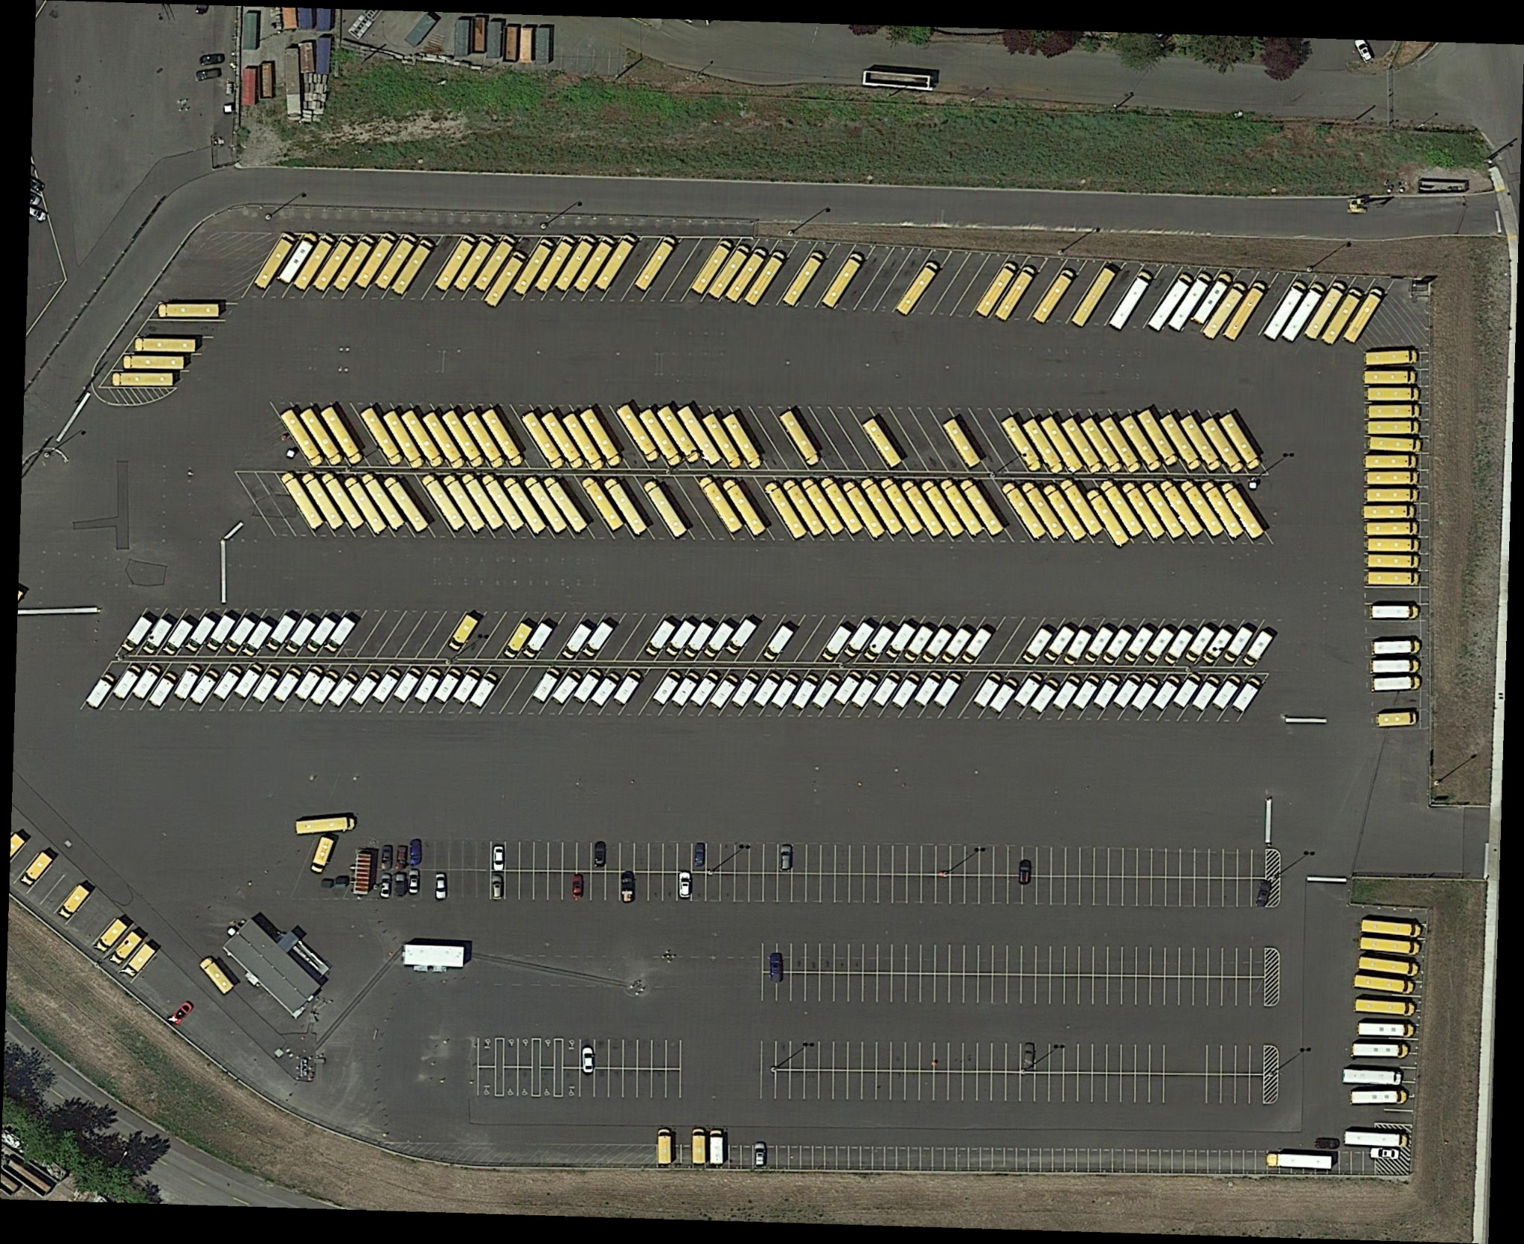
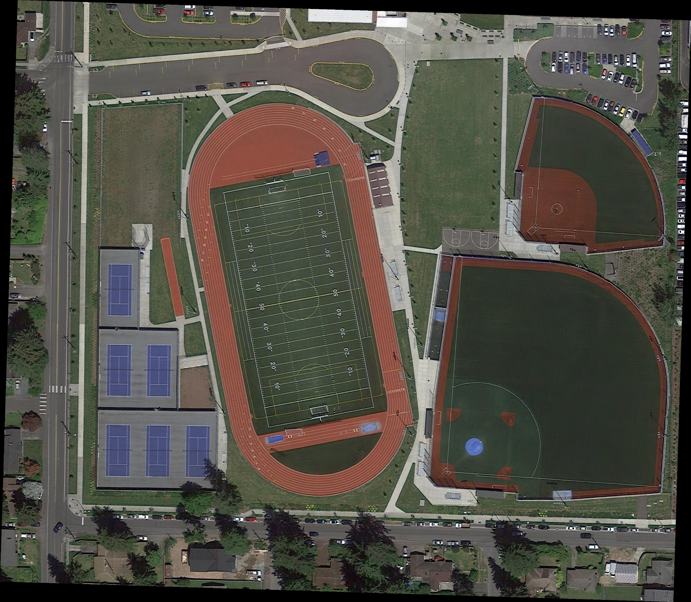
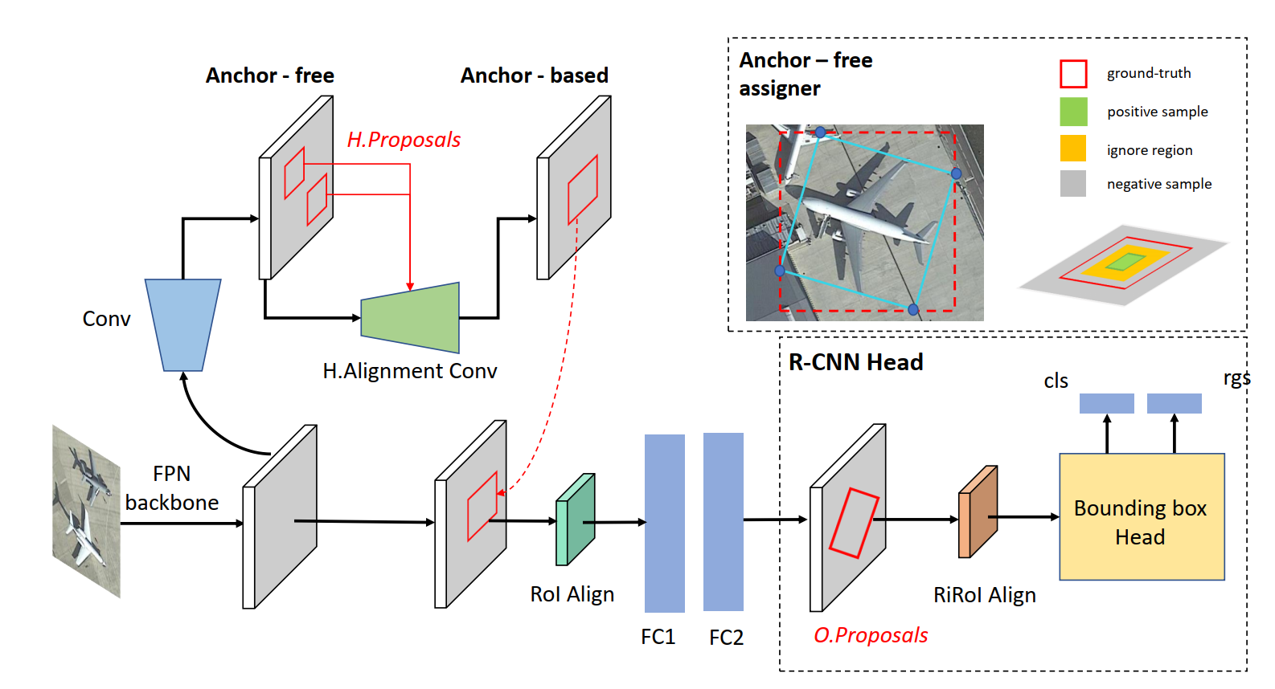
HA-RDet : Hybrid-Anchor Rotation Detector for Oriented Object Detection
Nguyễn Đức Anh Phúc^{1,4}
Huỳnh Viết Tuấn Kiệt^{2,4}
Trần Văn Lực^{3,4}
{¹20520276, ²20521494 ³20521587}@gm.uit.edu.vn
⁴University of Information Technology, Ho Chi Minh City, Vietnam
What ?
Why ?
We propose a model for oriented object detection in Aerial Images, in which we have:
Most oriented object detection methods follow an anchor-based mechanism to predict heavily encoded oriented bounding boxes. They often generate redundant anchors of varying proportions for "greedy" allocation as much as versions of different shapes and sizes. This trend leads to an exponential number of anchors required for the models to achieve promising performance, resulting in a high demand for computational resources. On the other hand, anchor-free only requires a single anchor for each position of the feature map; however it works fast but accuracy will decrease due to lack of training samples.
A combination of Anchor-free and Anchor-based training scheme for Oriented Object Detection in Aerial Images.
Bridging the gap between one-stage and two-stage.
Achieving state-of-the-art performance while having approximately the same processing speed as current models
Overview
Model
Deep learning
Model
MODEL
HA-RDet
INPUT
OUTPUT
An aerial image provided from the DOTA dataset.
An image contains the corresponding set of Oriented Bounding Boxes of the objects appearing in the image.
Description
1. Research Content
2. Proposed method
Proposal Transformation Network
Investigating methods of detecting oriented objects in aerial images.
Proposing a model of object detection in aerial images using a combination of Anchor-Free and Anchor-based mechanisms.
Proposing three experimental R-CNN heads for the problem of detecting oriented objects in the aerial view.
Evaluating three backbones on oriented object detection models in aerial images.
Experimenting with oriented object detection methods in aerial images on three well-known datasets for evaluation.
We design a lightweight network to transform horizontal proposals generated by the RPN to oriented proposals with the Midpoint-offset encoder.
The transformed oriented proposals then are fed to RCNN heads for refinement procedures.
3. Expected outcome
Hybrid-Anchor alignment RPN
Build a complete model with the Hybrid Anchor combined architecture. Successfully tested the built model with a combination of different backbones and RCNN heads.
The final model expected achieve better accuracy while achieving approximately the same processing speed as the current models performed on the problem of oriented object detection in the aerial image.
Anchor Generator: We use only one anchor preset with 1 scale and 1 ratio for each position of the feature map using the Anchor-free mechanism.
Bridged Extracted Features: After extracted features X is passed through the Conv layer to X' to predict the H.Proposals. On each feature map location, a preset anchor with the same scale and ratio is generated with the kernel of the conv sliding across the feature map. The X' features along with the H.Proposals are passed through the H.Alignment Conv and finally refined by the Anchor-based head.
UIT – University of Information Technology
TEL : ********** Email : 2052****@gm.uit.edu.vn
Notes:
‹#›

